Slide 1
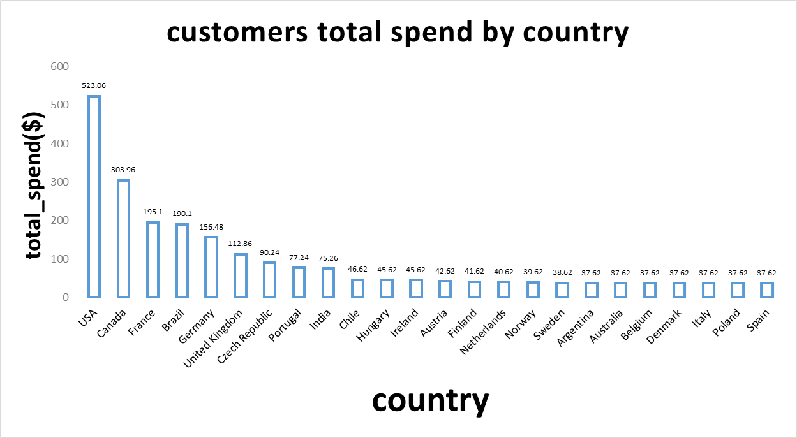
What is the country with most spend money ?
We can see in first place came USA to have the most customers spending money with total 523.06 money
And in the other side Spain came in end of list

Slide 2
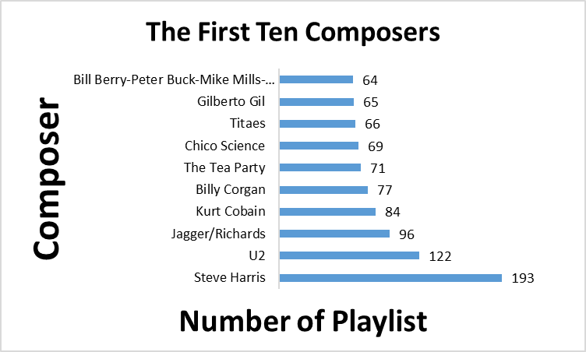
What is the first ten composers ?
We can see that Steve Harris came in the first place of The most productive songs by produce 193 playlist

Slide 3
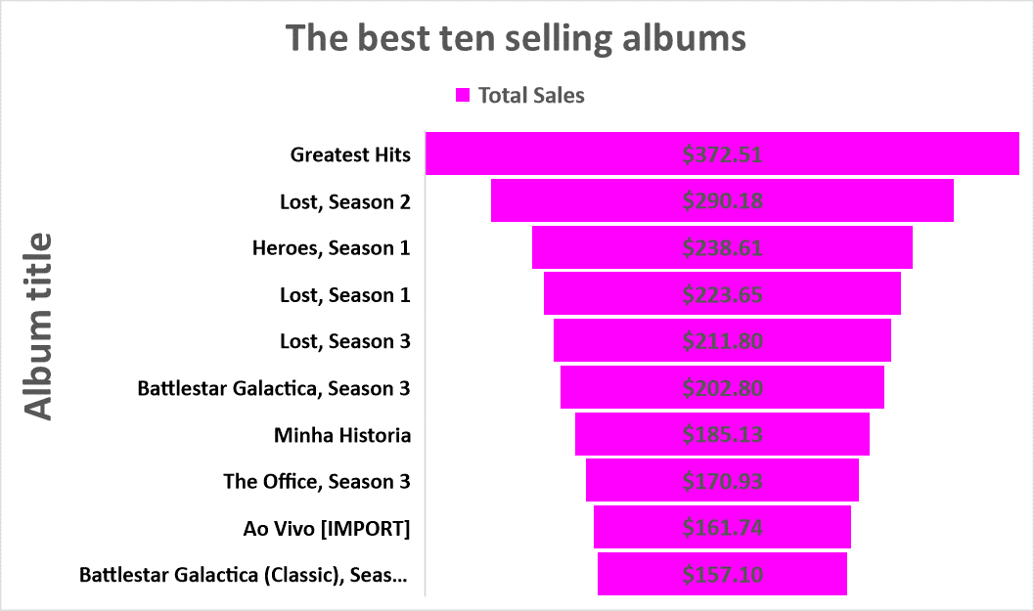
What is the best ten selling albums ?
We can see that Greatest Hits came in the first place for the list of best ten selling albums with 372.51$

Slide 4
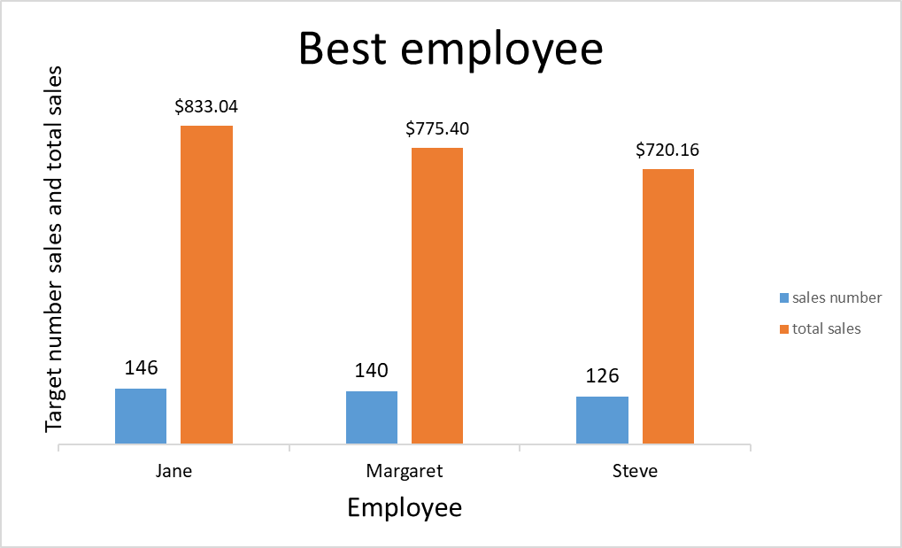
What is the best employee ?
We can see that jane is the best emplyee by making 146 sales operation with total 833.04$

